Slide 1

BPF_PROG_TEST_RUN: the hidden perils of testing.
Lucas Castanheira and Theophilus A. Benson
Carnegie Mellon University

Slide 2
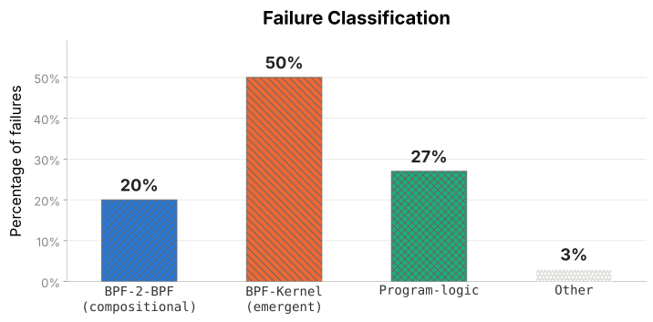
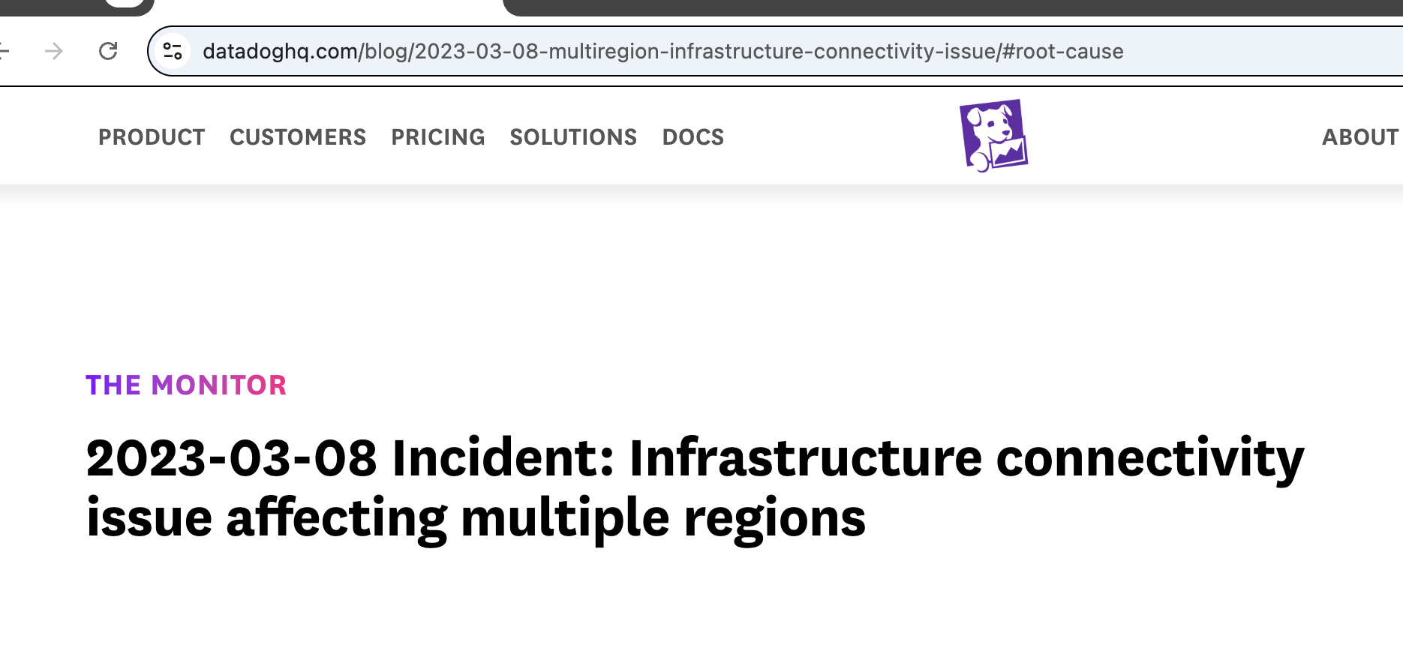
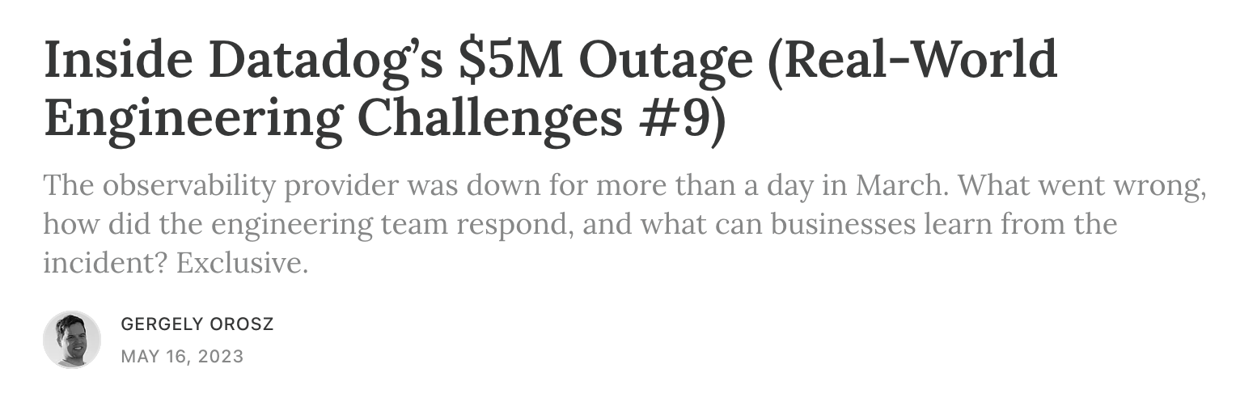
The verifier is not enough
(never was)
Latent kernel bugs
Safe to load is not the same as correct or safe to load :)
The verifier ONLY proves a program is bounded and memory-safe.
Logical bugs
in YOUR program
2

Slide 3

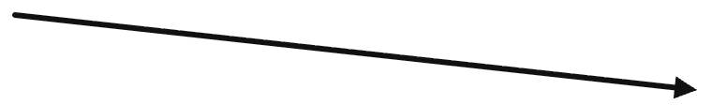




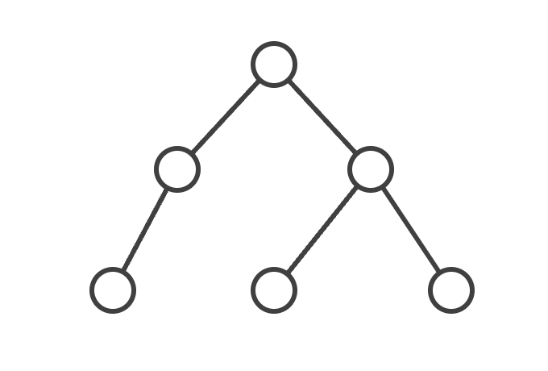






How do you test your eBPF programs?
Analyze single program behavior
Analyze program interactions with …
Human imprecision
Models of helpers
Manually defined context
Program
Testing
Chaos
Unit
tests
Symbolic
execution
A/B
testing
Chaos
engineering
4

Slide 4
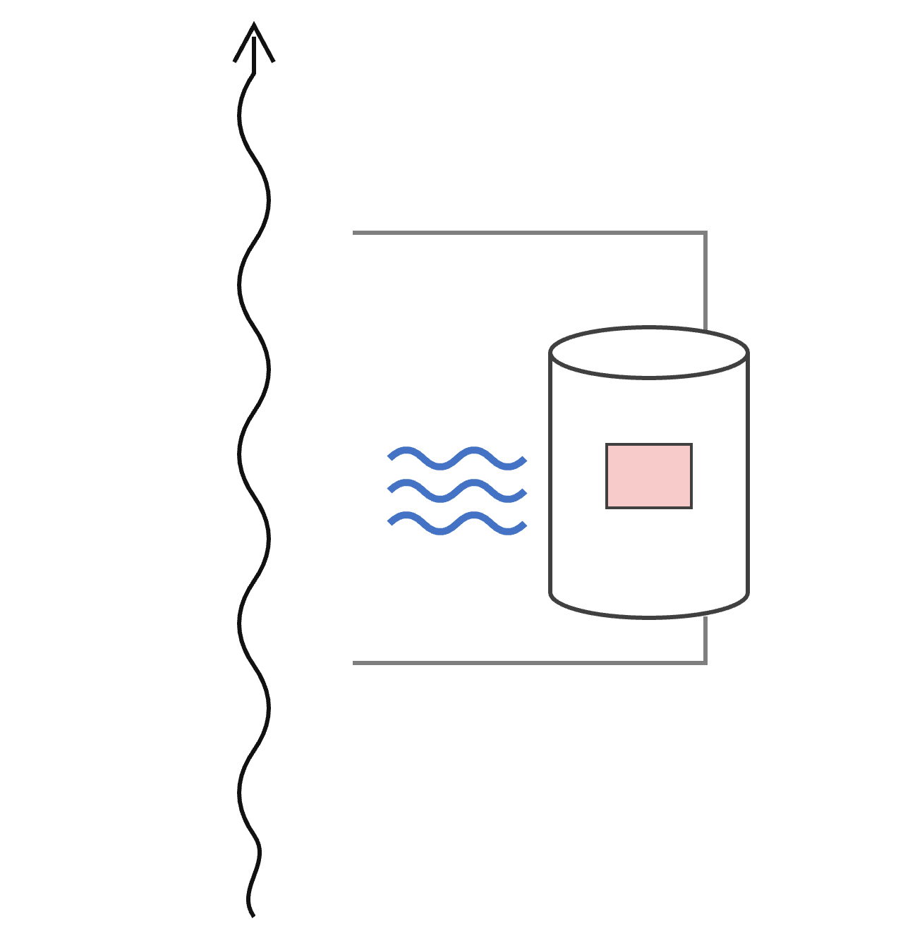



In production, state builds up
Kernel
Helpers alter state
State
Context builds up
Program
Context alters, and is altered by,
other subsystems
Host / NIC config impacts context
Host / NIC
6

Slide 5








Unit tests run a test recipe, not the kernel
“Relevant” context
Correctness
Production kernel
BPF_PROG_
TEST_RUN
Load & run
1
Host / NIC config
Test recipe
Input context object
?
2
Context build-up
Packet data
Program
3
Helper side effects on other subsystems
4
Test recipe overrides
Parts of the test recipe overridden
7

Slide 6
Unit tests run a test recipe, not the kernel
“Relevant” context
Correctness
Production kernel
Kernel
BPF_PROG_
TEST_RUN
Load & run
1
Host / NIC config
Test recipe
Input context object
State
?
2
Context build-up
Packet data
Program
Program
3
Helper side effects on other subsystems
4
Test recipe overrides
Host / NIC
Parts of the test recipe overridden
7

Slide 7

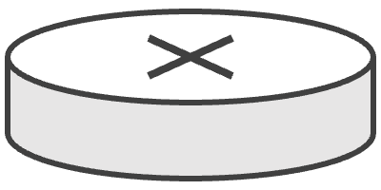


So many problems …. Where do we start?
Program
Program
GRO
Jumbo
Jumbo
MTU
MTU = 1200
MTU = 640000
Router
Can't configure different MTUs in one namespace
Homogeneous config in a namespace
17

Slide 8


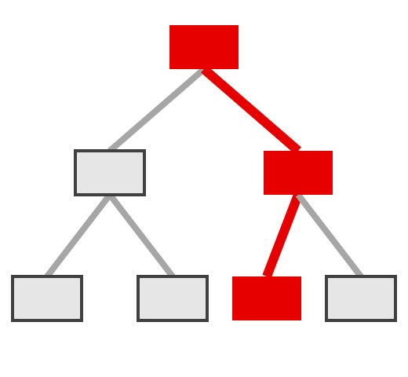
Empirical versus static analysis
Empirical
Static analysis (bytecode)
Static analysis
(taint tracking)
eBPF
Traffic
vs
Kernel
Run the program in the kernel on real traffic and observe behavior
Inspect the program's code
(source or byte)
Follow values through the code
Compute intensive and takes too much time
False positives and incomplete
FUTURE WORK!!!
10

Slide 9

Two analysis pipelines: test recipes and helper side effects
Test recipe overrides
Identify settable fields
Diff set vs. observed
Trace through the harness
Overridden fields
Both run on bpf_prog_test_run_skb and bpf_prog_test_run_xdp, kernels v6.12 to v7.2 (11 releases)
11

Slide 10
Test recipe analysis: overridden fields
XDP (xdp_md): 3 fields
TC (__sk_buff): 17 fields
VLAN
3
// set in your test recipe, then overridden:
Traffic control
2
ctx->ingress_ifindex
Queue / hash / NAPI
3
ctx->rx_queue_index
rxq->dev
Network
3
data_meta
1
All overrides are sanity checks to make sure NIC related data is set
Other
5
Network: family and addresses. Traffic control: tc_index, tc_classid.
12

Slide 11
Impact of test recipe overrides
Helpers that depend on each field
// bpf_prog_test_run_skb(), simplified
cloned
16
// your test recipe's values are replaced:
skb->dev = net->loopback_dev; // always loopback
sk
12
dev
7
skb->sk = dummy_sk; // no real socket
ingress_ifindex
5
skb->cloned = 0; // forced uncloned
rxq->dev
5
skb->ip_summed = CHECKSUM_NONE; // resets checksum
ip_summed
5
skb->vlan_tci = 0; // strips VLAN
gso_type
3
skb->gso_type = 0; // disables GSO
vlan_tci
2
Blue: sk_buff. Orange: XDP.
Programs branching on cloned (16 helpers), sk (12) or dev (7) always take the same path: the other branch is never explored or tested
13

Slide 12
Impact of test recipe overrides
Helpers that depend on each field
cloned
16
sk
12
dev
7
ingress_ifindex
5
rxq->dev
5
ip_summed
5
gso_type
3
vlan_tci
2
Blue: sk_buff. Orange: XDP.
Programs branching on cloned (16 helpers), sk (12) or dev (7) always take the same path: the other branch is never explored or tested
13

Slide 13

So many problems …. Where do we start?
// bpf_prog_test_run_skb(), simplified
// your test recipe's values are replaced:
Program
Program
skb->dev = net->loopback_dev; // always loopback
GRO
skb->sk = dummy_sk; // no real socket
Jumbo
Jumbo
skb->cloned = 0; // forced uncloned
MTU
skb->ip_summed = CHECKSUM_NONE; // resets checksum
skb->vlan_tci = 0; // strips VLAN
skb->gso_type = 0; // disables GSO
MTU = 1200
MTU = 6400000
Router
Can't configure different MTUs in one namespace
Homogeneous config in a namespace
17

Slide 14
Two analysis pipelines: test recipes and helper side effects
Test recipe overrides
Identify settable fields
Diff set vs. observed
Trace through the harness
Overridden fields
Helper side effects
Identify relevant helpers
Filter by missing subsystems
Analyze code paths
Classification
Both run on bpf_prog_test_run_skb and bpf_prog_test_run_xdp, kernels v6.12 to v7.2 (11 releases)
11

Slide 15
Untested behavior: missing environment
Silent error and missing cases by root cause
Example: socket lookup in an empty namespace
SKB
XDP
Missing socket
12
12
sk = bpf_sk_lookup_tcp(skb, &t, sizeof(t.ipv4),
7
BPF_F_CURRENT_NETNS, 0);
Missing interface
3
if (!sk)
6
return TC_ACT_OK; // always taken
Missing route / FIB
6
// never reached under the harness:
if (sk->state == BPF_TCP_LISTEN)
Missing cgroup
4
handle_listener(skb, sk);
4
bpf_sk_release(sk);
Other (ring buffer)
2
2
Illustrative program. No listening sockets exist, so the lookup always returns NULL.
14

Slide 16
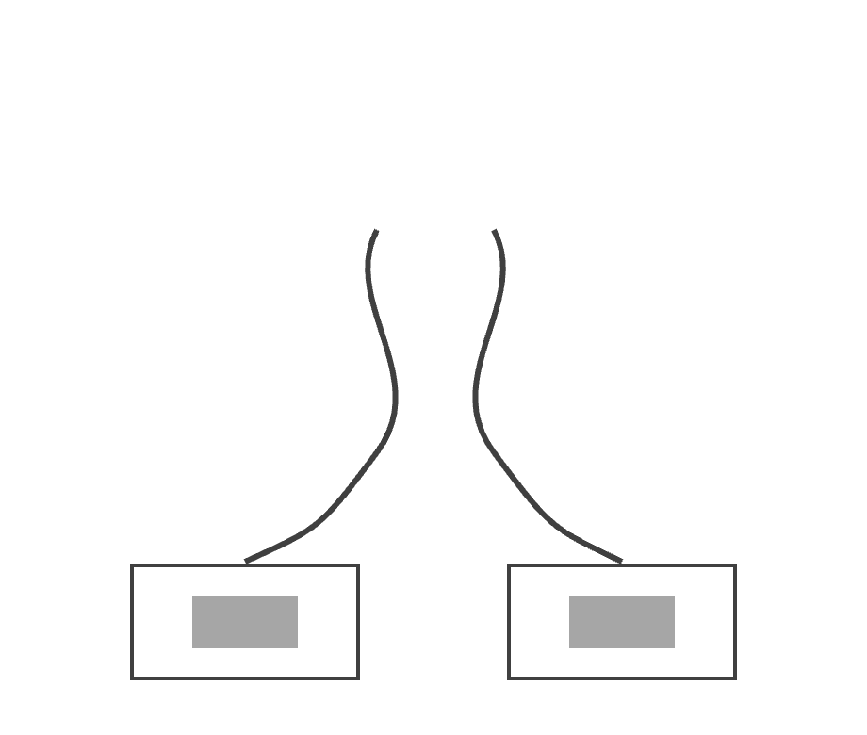
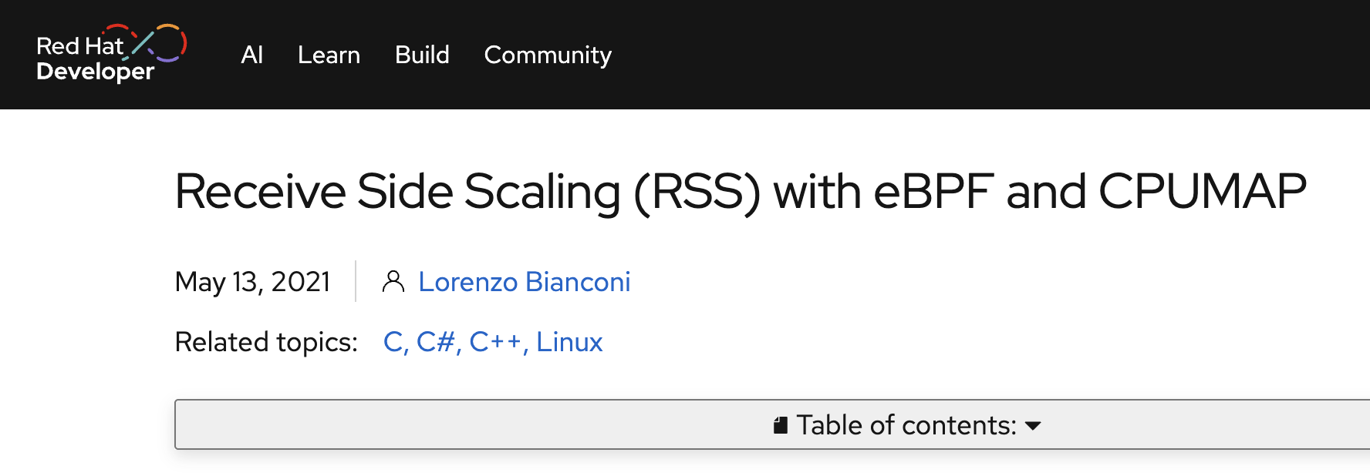
Untested behavior: missing environment
Silent error and missing cases by root cause
Think load balancing …
SKB
XDP
Program
Missing socket
7
?
?
Missing interface
3
Missing route / FIB
6
6
Missing cgroup
4
Interfaces
4
Helpers that use interface info are not exercised
Other (ring buffer)
2
2
14

Slide 17
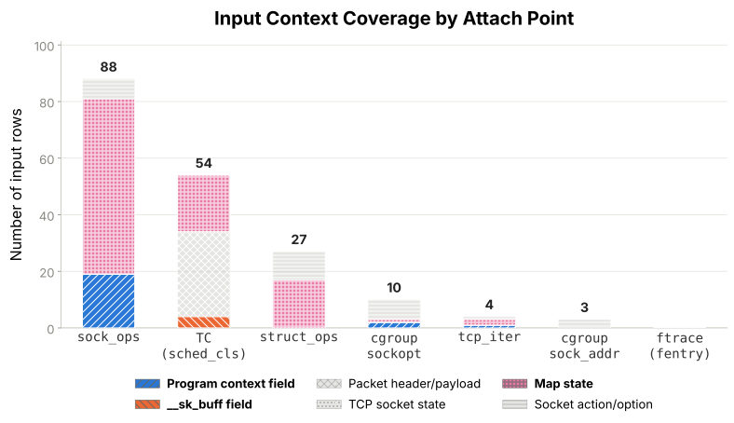
Test Recipes at … a hyperscaler
“Relevant” context
BPF_PROG_
TEST_RUN
Test recipe
Input context object
Packet data
Program

Slide 18
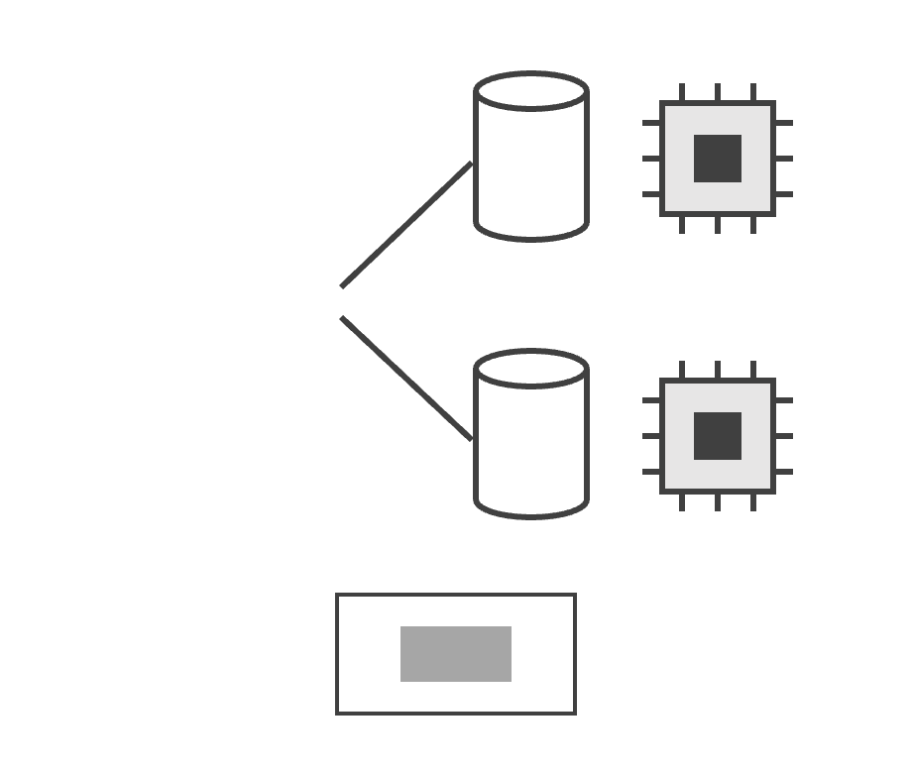
Test Recipes at … a hyperscaler
?
Program
CPU 0
?
CPU 1
Per-CPU maps are ignored as there is only one CPU

Slide 19

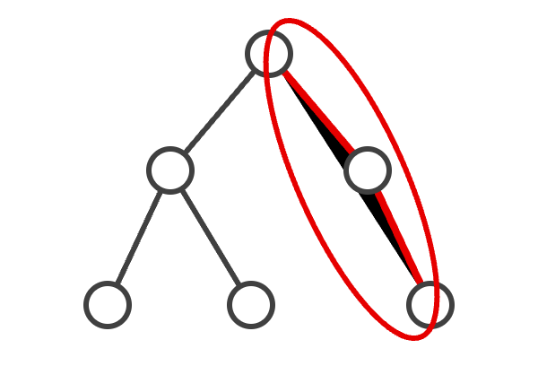


What Does this Enable …
Migrate a program
Automate helper model creation
kprobe + kretprobe
fentry + fexit
Instantiate test recipe
Helper model
≈
LLM
≈
Demonstrate equivalence
Minimal subset of a helper to realize a code path, validated empirically
19

Slide 20

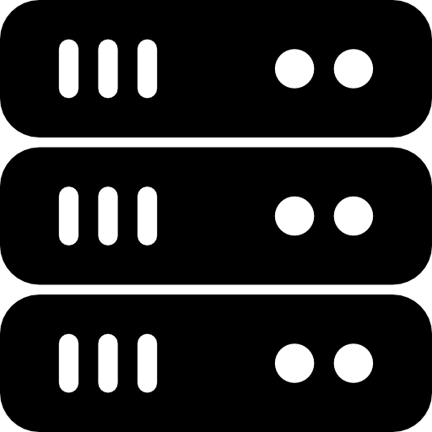
Takeaways
Testing misses conditions
Started with networking
Verifier oh, verifier
Behavior is obviously not the same as production but coverage is the hidden danger
Networking requires complex topologies to provide coverage
There are dragons everywhere and the verifies needs help …
20

